Slide 1
Credit 101
Disclaimer: This presentation is not intended to provide financial assistance or guidance. It should solely be used as an education tool.

Slide 2
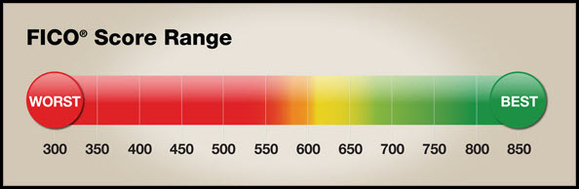
Scope
We will be focusing on people who range between moderate to good credit rather than those who have bad credit. Those who do have bad credit may not find this presentation helpful, but they may find it informative.
Notes:
This powerpoint is intended for those who have okay to really good credit, not for those with bad credit.

Slide 3

What is a Credit Score?
“A number assigned to a person that indicates to lenders their capacity to repay a loan.”
Via Oxford Dictionary
Notes:
A credit score is just a number between 300 and 850 that indicates their ability to repay a loan based on past actions.

Slide 4
Credit 101
How to:
Increase Your Credit Score
Decrease Your Credit Score
Pay off bills and loans on time
Pay at least the minimum payment due on time
Pay off past due accounts
Dispute any errors or activity that’s not yours
Keep diverse forms of credit
Refrain from applying for credit needlessly
Avoid derogatory marks (bankruptcy, foreclosure,
collections, tax lien, or civil judgement)
Keep accounts open
Improve debt to credit ratio (low debt, high line
of credit)
Ask for good faith adjustments
Late payments or no payments at all
Opening a lot of new accounts, especially at
one time
Closing accounts, even if they’re not in use
Co-signing on someone else’s credit
Maxing out credit cards
Buying unaffordable things
Filing for bankruptcy, turned over to collection
agencies, foreclosing property, or not paying taxes
Not using credit cards at all
Using solely one credit card
Forgetting even small payments, such as parking
tickets
Notes:
A few highlights:
To increase your credit score
Pay off at least the minimum on all bills and loans
Keep diverse forms of credit
Loans
Credit cardsssss (plural)
Mortgages
Any way to prove you can pay off debt
Don’t open and close accounts rapidly
Avoid getting into debt
How to decrease your credit score
Having late payments or no payments at all
Opening and closing new accounts constantly
Opening a ton of accounts
Getting into debt and maxing out cards, bankruptcy, foreclosing, etc.

Slide 5
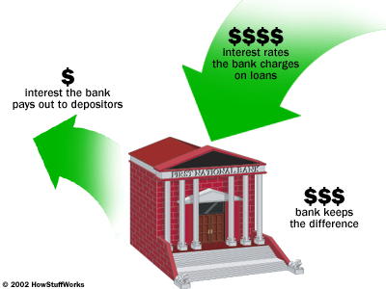
Banking 101
The Net Interest Margin (NIM) - the difference between the interest paid to the account holders/depositors and the interest generated by the banks.
This is the most common way and largest source for bank funding.
Notes:
Take deposits from account holders
Invest this money by loaning it out.
The bank generates a small interest rate, usually ranging .06-1.2%, for the depositor’s benefit.
The bank uses the depositors’ money to offer loans, charging the borrowers interest.
The interest rates for loans are larger than the interest rates given to depositors, so the bank is able to make a profit.

Slide 6

Fundamentals on Using a Credit Card
Pay off your credit card every month
At least make the minimum payment required
It’ll increase your credit score
Credit Card Limits:
Credit Limit - the maximum amount of money that can be charged to a credit card
Dependent on the credit card holder
The higher the credit score, usually the higher the credit card limit
Notes:
You need to pay off at least the very minimum payment of your credit card bill if you do not want to face extra fees or make your credit score go down.
If you make regular payments on your credit card, your score will go up over time!
Then you have credit card limits. A credit card limit is the maximum line of credit you have available to charge to that card.
This limit is determined by your credit score and varies per person.

Slide 7

Fundamentals on Using a Credit Card
What if you don’t make payments?
Incur late fees and/or interest, determined by the annual percentage rate (APR) of the credit card
If there’s no payment within one billing cycle (30 days),
the credit card issuer can report the card holder to the credit bureaus
May affect credit score
If there is still no payment on the bill (90+ days),
The issuer will report the debt as a loss or charge-off.
This will impact credit score worse than before.
Can receive a 1099-C form from the IRS
Will have to pay taxes on the debt
The creditor also has the option to take legal action
Moral of the story: pay credit card bills on time!
Notes:
What if you don’t make payments?
You’ll incur late fees and/or interest determined by the annual percentage rate (APR) for your credit card
If you still don’t pay your bill within one billing cycle (30 days), your credit card issuer can report you to the credit bureaus, which affects your credit score
If you still do not pay your bill (90+ days), the issuer will report the debt as a loss or charge-off. This will impact your credit score worse than before
You could receive a 1099-C form from the IRS and have to pay taxes on the debt
The creditor also has the option to take legal action against you
Moral of the story: pay your credit card bills!

Slide 8
Pros & Cons of Having a Credit Card
Pros
Cons
Don’t pay debt immediately
Free rewards
Cash back, prizes, vouchers, etc.
Builds credit
Easier to get loans, mortgages, higher credit limit
Zero liability
Card company responsible for fraud
Credit card accepted virtually anywhere
In person, online, globally, it doesn’t matter!
Good to have in case of an emergency
Convenient
There are consequences if at least the minimum payment is not paid
As shown in last slide
Necessary to keep track of how much is spent
The consumer can spend more than they can afford and get into debt
Amount spent doesn’t come directly from bank accounts at the time of the transaction
Possibility of credit card fraud and liability, depending on the issuer’s policy
Possible hidden fees
Notes:
Pros:
You don’t have to pay your debt immediately
Free rewards
Can be cash back, prizes, vouchers, etc.
Builds your credit for a higher credit score
Easier to get loans, mortgages, higher credit limit
Most credit card companies have 0 liability
You’re not responsible for fraud or spending that was not yours
You can use a credit card virtually anywhere
In person, online, globally, it doesn’t matter!
Good to have in case of an emergency where you can’t pay the full amount at the moment
Convenient to have
Cons:
If you do not pay your bill, at least the minimum payment, there are consequences (as shown in last slide)
You need to keep track of how much you spend
You can spend more than you can afford and get into debt
The money doesn’t come immediately out of your account, so it’s easy to spend more than intended
Possibility of credit card fraud and liability, depending on the issuer’s policy
Possible hidden fees

Slide 9
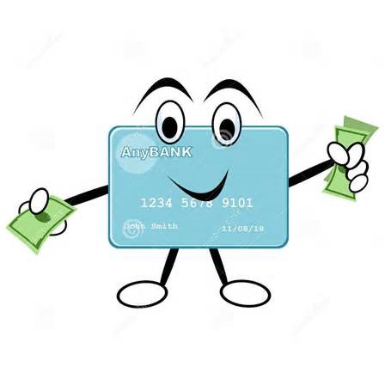
Types of Credit Cards
Standard or “Plain-Vanilla”
Premium
Generic Travel Rewards
Co-Branded Rewards
Cash Back
Notes:
Five types of credit cards I will cover today which are:
Standard, also known as “plain vanilla”
Premium
Generic Travel Rewards
Co-Branded Rewards
Cash back

Slide 10
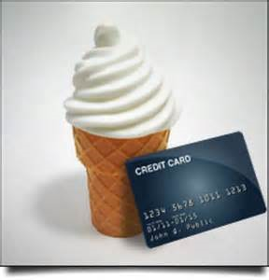
Standard or “Plain-Vanilla” Credit Cards
Basic credit card
Absolutely no rewards or cashback
Simplest type of card
Spend and pay bills monthly
May be a good credit card to begin with
Examples Include:
Standard MasterCard
BOA’s Plain Vanilla Credit Card
Chase Blueprint
Notes:
First off with standard or plain vanilla cards
It’s your basic credit card, where it doesn’t offer any perks or rewards.
Usually a good starter credit card. You still get the benefits of possessing a credit card, but you don’t get any money or rewards back.

Slide 11
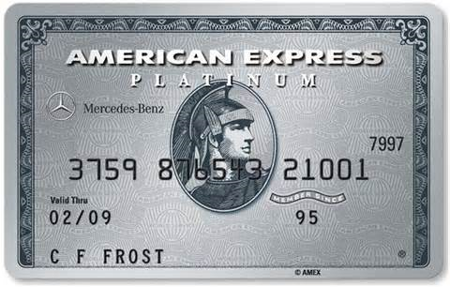
Premium Credit Cards
Offers exclusive
benefits,
priority access,
and excellent service
Usually for a fee
Originally only for the extremely wealthy and considered very prestigious
Examples include:
American Express Platinum Card
Citi Prestige Card
Visa Black Card
J.P. Morgan Select
Notes:
Premium credit cards are cards that contain a lot of benefits and rewards but are for those with good credit.
Also, these cards usually charge a rather high annual fee.
These cards are about weighing your options
Will you come out ahead with the benefits your getting vs. the annual fee?
Are you getting the card just for the “prestige” that comes with it, or will you actually benefit from the rewards it offers?

Slide 12



Generic Travel Rewards Credit Cards
Earn generic points/miles for travel expenses
Points accrued as purchases are placed on the card
Can be more convenient than specific airline cards
Use towards any airline
Examples include:
Capital One VentureOne Rewards Card
Citi Prestige Card
Barclaycard Arrival World MasterCard
Chase Sapphire Preferred Card
Notes:
Generic credit cards offer rewards points or mile points that allow you to accumulate points for free miles on flights.
These cards are convenient and flexible because they can be used towards any airline rather than a specific one.
The value of the points may be less than a specific airline’s co-branded credit card.

Slide 13



Co-Branded Rewards Credit Cards
Categories:
Hotel
Airline
Retail
Notes:
Shift into co-branded rewards credit cards. There are 3 major categories:
Hotel
Airline
Retail

Slide 14
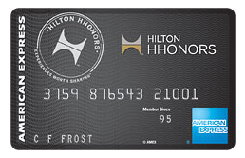
Hotel Co-Branded Rewards Credit Cards
Offer rewards, such as accrued points
Points accrued as purchases are placed on the card
Points are used towards hotel rate discounts or free nights
Some cards also offer other benefits such as
Cashback
Deals
For example, buy 3 nights, get 1 free
Late check out times
Sign up bonuses
Examples include:
Hilton Hhonors Card from American Express
Marriott Rewards Card from Visa
Starwood Preferred Guest Card from American Express
Hyatt Credit Card from Visa
Notes:
Hotel co-branded cards usually go by a point system, where points are accrued when purchases are placed on the card.
The points that accrued go towards hotel stays.
There are some extra benefits hotel cards offer, which usually include
Cashback,
Extra deals,
Late check out times,
And sign up bonuses such as free cash or free nights

Slide 15
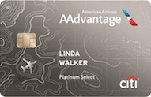
Airline Co-Branded Rewards Credit Cards
Accrue points to use towards flights
Points accrued as purchases are placed on the card
Earn free flights for the card specified airline
Airline affiliated cards also offer at airport perks, such as:
Free bag check fees
Priority boarding
Priority security
In airport lounges
Examples include:
Citi/Aadvantage Platinum Select MasterCard
Southwest Airlines Rapid Rewards Premier
Credit Card
Gold Delta SkyMiles Credit Card from American
Express
Alaska Airlines Visa Signature Card
Notes:
Airline co-branded rewards cards work very similar to the hotel co-branded cards, but they offer different perks.
This card is different from the generic travel reward cards because it is airline specific. It’s rewards can only be used for flights offered by that airline.
These cards offer extra perks such as
Free bag check fee
Priority boarding onto the flight (one of the first groups to board the plane)
Priority security checks (move quickly through security by jumping ahead)
& in airport lounge access

Slide 16
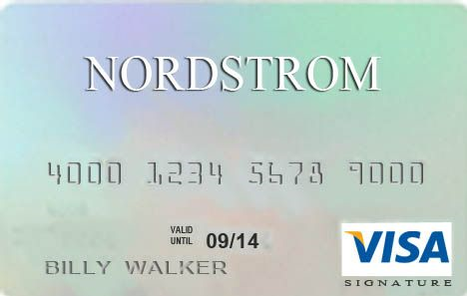
Retail Co-Branded Rewards Credit Cards
Retail credit cards are very popular
Provide a variety of retail benefits, such as:
Cashback
Accrued points to be used for future purchases
In store benefits
Discounts
Coupons
Priority sales
Sign up bonuses
Total purchase discount
Store voucher
Examples include:
Nordstrom Signature Visa Card
Amazon.com Rewards Visa Card
Toys R Us Rewards MasterCard
Macy’s American Express Card
Notes:
Retail co-branded rewards credit cards are pretty popular and if you shop, you hear about them all the time.
These are the cards stores push for you to sign as you’re checking out.
They can provide a wide selection of offers including
Discounts or coupons you receive as a card member,
Priority sales before the general public,
Sign up bonuses (usually a discount on your current purchase when you sign up)
Good to think about which stores you frequently shop at and would save the most at

Slide 17
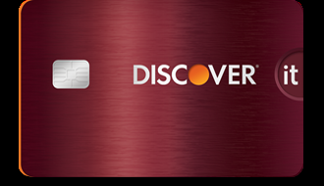
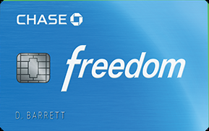
Cash Back Cards
Rotating Categories
Receive cash back on certain purchases
Depending on the current offer
Examples:
Discover it
Citi Dividend Platinum Select Visa Card
U.S. Bank Cash+ Visa Signature Card
Capital One Quicksilver Cash Rewards Credit Card
No Category
Get the same amount of cash back on every purchase
Does not matter what the purchase is
Does not matter when the purchase is placed
Examples:
Chase Freedom
Citi Double Cash Card
Barclaycard CashForward World MasterCard
Fidelity Rewards Visa Signature Card
Notes:
There are different types of cash back cards:
Rotating categories,
No category,
And market specific categories
Rotating Categories allow you to receive cash back only on certain purchases.
The purchases you can receive cash back on change frequently, usually every 3 months.
This can be good if you make a variety of purchases, but can be bad because you have to track which purchases you can get cash back on at the moment.
No category credit cards let you get cash back on any purchase at any time.
A flat rate of cash back is set, usually 1% back on each purchase.

Slide 18


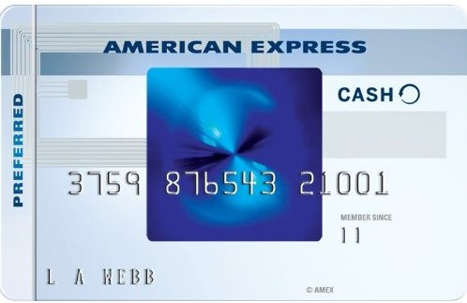
Cash Back Cards (Continued)
Market Specific Categories
Mixture between different cashback options, such as:
Gas
Groceries
Restaurants
Retail
Specific merchant purchases
Examples:
American Express Blue Cash Preferred Card
BankAmericard Cash Rewards Card
Wells Fargo Propel American Express Credit Card
Amex EveryDay Credit Card
Notes:
The last category of cash back cards is market specific cards.
Market specific cards offer cash back on purchases within certain categories.
You can get more cash back on certain categories than others.
For example, you can get 3% cash back on gas and grocery purchases and then 1% on everything else.

Slide 19
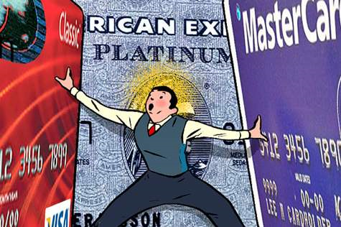
Key Benefits of Credit Cards
Standard Benefits
Other Important Benefits
Signing Bonus
Limits
Notes:
Major key benefits to look for in credit cards.
These benefits include
Standard Benefits
Other important benefits
Signing bonus &
Limits

Slide 20

Standard Benefits
Global Customer Assistance Services
Examples include:
Cardholder Inquiry Service
Product
Service
Benefits
Emergency Card Replacement
Stolen
Lost
Damaged
Emergency Cash Disbursement
Lost/Stolen Card Reporting
Price Protection
Notes:
Global Customer Assistance Services
Examples include:
Cardholder Inquiry Service
Information service available for cardholders via phone
Product
Service
Benefits
Emergency Card Replacement
New card can be issued if the original card is
Stolen
Lost
Damaged
Emergency Cash Disbursement
Emergency cash available to cardholders who are traveling domestically or internationally
For example, if their card is stolen, lost, or damaged
Lost/Stolen Card Reporting
If a card is lost, stolen, or subject to fraud, the card can be blocked to minimize losses
Price Protection
If a cardholder makes a purchase if their card and find the same item elsewhere at a lower price, price protection will refund the difference

Slide 21
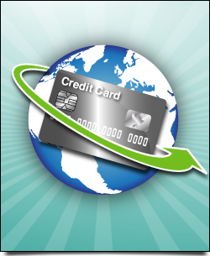
Other Important Benefits
Foreign Transaction Fees
Preferably zero
Balance Transfer
Rewards Qualification
0% Intro APR
Minimum Payment Options
Late Payment Forgiveness
Notes:
Foreign Transaction Fees
Fees charged by most credit card companies on purchases made in foreign currency, or on purchases that involve a foreign bank
Preferably these fees are 0
Balance Transfer
The transfer of a balance in an account to another account, often to another institution
Rewards Qualification
Qualifications required for a cardholder to be eligible for certain rewards
0% Intro APR
Introduction 0% interest rate when a credit card is opened is sometimes offered, usually ranging between 6 to 18 months
Minimum Payment Options
Options for the lowest amount of money you’re required to pay towards your credit card statement each month
Late Payment Forgiveness
Some credit card companies allow late payment fees and waived interest rates

Slide 22

Signing Bonus
Some credit cards offer signing bonuses
Free cash
Extra rewards
Extra points
Discounts
Waived annual fee
Receive cash back or rewards after initially or after spending a certain amount in an allotted period of time
Examples include:
Chase Sapphire Preferred
Chase Freedom
Blue Cash Everyday Card from
American Express
Mercedes-Benz Platinum Card
from American Express
Notes:
Many credit cards offer a signing bonus when you sign up for their card.
These bonuses can include, but aren’t limited to:
Free cash offers
Extra free rewards
Extra “earned” points
Discounts on merchandise or services
Or waived credit card annual fee, if there is one
One of the features is free cash if you spend a certain amount in a select period of time.

Slide 23

Points Vs. Cash Back
Need to ensure at least a 1:1 match
Cash back offers the most flexibility
Selection of rewards can be limiting
May end up getting a better value with reward points
Cash back can be selective
May only apply to specific transactions
Notes:
Cards can offer either points or cash back.
There are pros and cons to each of these cards.
Cash back offers more flexibility because you’re actually getting cash and can use it on whatever you’d like.
The selection of rewards you can get may be limiting compared to cash back, but you may actually end up getting more value with the points.

Slide 24
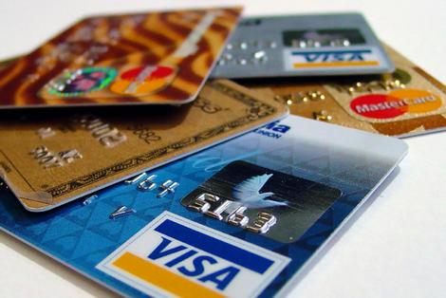
U.S. Credit Card Statistics
71% of Americans have credit cards (April 2014)
Americans have an average of 2.6 credit cards (April 2014)
33% have 1-2 cards
18% have 3-4 cards
9% have 5-6 cards
7% have 7 or more cards
329 million U.S. Visa credit cards in circulation (Sept. 2015)
192 million U.S. MasterCard credit cards in circulation (Dec. 2015)
57.6 million U.S. American Express credit cards in circulation (Dec. 2015)
The average U.S. credit card debt is $5,164 per adult (Q1 2014)
Source: CreditCards.com
Notes:
Here are some quick U.S. credit card statistics.
71% of americans have credit cards
This is A LOT considering you have to factor in those who do not have credit cards may be young adults who do not have a credit history.
On average, each American has 2.6 credit cards
A lot of Americans like to have back up credit cards in case something happens to their primary credit card
Not a bad idea
A lot of Americans also sign up for credit cards to get initial deals such as a discount on their purchase or cash back and may not use their card frequently.
There are those who actively use more than one card.
They may not want to put one large bill on a single card.
The average U.S. credit card debt is $5,164 per person, which

Slide 25
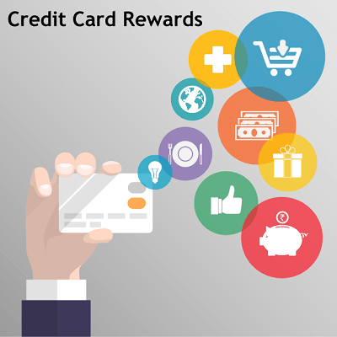
Credit Card Rewards Rates
Earn Rate – the amount of cash back, points, or miles you receive on every dollar spent on a credit card
Find the right card that fits you
Best rewards may be flexible rewards
Most average reward rate is 1% for every dollar spent
Usually cards with the highest rewards have an annual fee
Some credit card rewards can be introductory and change through the course of time
Get a beneficial rewards program that will benefit you in the end
Source: CreditCards.com
Notes:
Earn Rate – the amount of cash back, points, or miles you receive on every dollar spent on a credit card
Find the right card that fits you
Finding a card with the highest rewards, but with not much relevancy to your spending habits may not be best
For example, if you get an airline rewards card and never fly, that will not be rewarding to you
Best rewards may be broad rewards
Rewards that can be redeemed for a variety of things
Most average reward rate is 1% for every dollar spent
Usually cards with the highest rewards have an annual fee
Is it worth it? Will you benefit from this or be better off with a lower rewards rate credit card with no annual fee
Some credit card rewards can be introductory and change through the course of time

Slide 26
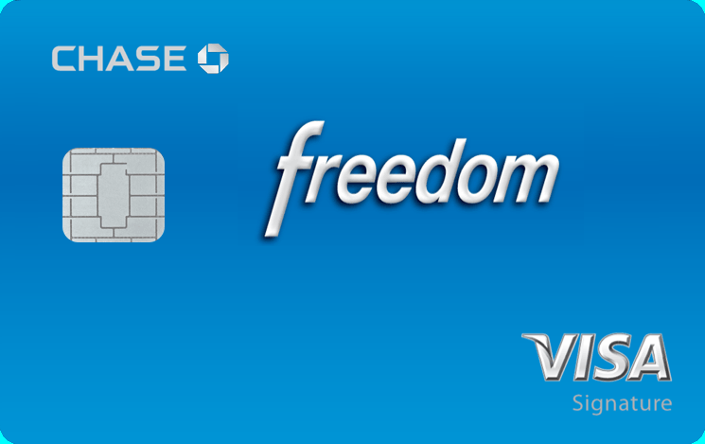
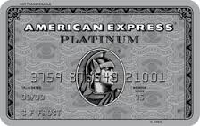
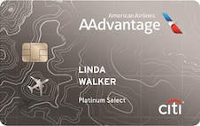
Four Credit Cards Comparison
Chase Freedom (Visa) | American Express Platinum | Capital One Venture Card | Citi/Aadvantage Platinum Select (MasterCard)
Cash Back | Premium | Generic Travel | Co-branded
Unlimited 1% cash back Select categories every 3 months w/ 5% cash back | Up to $200 airline fee credit Discounts/Low rates at hotels Hilton HHonors Gold Status benefits Baggage, rental car, travel, & flight insurance Purchase protection for damaged, stolen, or lost items 90 days after date of purchase | Unlimited 2 miles per dollar on all purchases Fraud coverage Complimentary travel upgrades and savings Shopping discounts Extended warranty | 2 American Airline miles per dollar spent on AA purchases 1 AA mile per dollar spent on all other purchases Earn 10% of redeemed miles back at the end of each year (up to 10,000 miles) First checked bag is free & group 1 boarding on domestic AA flights 25% savings on in-flight food
None | $450/yr. | $59/yr. | $95/yr.
14.24% -23.24% (V) | N/A, must pay in full each month | 13.24% - 23.24% (V) | 14.24% - 22.24% (V)
Check, for first 15 months | No check | No check | No check
$100 cash back after spending $500 within first 3 months | 40,000 rewards points after spending $3,000 within first 3 months | $0 first year intro fee; 40,000 miles after spending $3,000 within the first 3 months ($400 in travel) | $0 first year intro fee; 30,000 American Airlines bonus miles after spending $1,000 within the first 3 months
None; $15-$35 fee (depending on balance) | None; Up to $35 fee; If no payment for two periods in a row, fee is $35 or 2.99% of past due amount, whichever is greater | 25 day grace period; Up to $35 fee after | 23 day grace period; Up to $35 fee after
3% | None | None | None
Reward Category
Reward Summary
Annual Fee
APR
0% Intro APR
Introductory Signing Bonus
Late Payment Forgiveness
Foreign Transaction Fees
Notes:
Go through the chart, pretty detailed
Some take aways:
Chase Freedom has the highest APR among rewards cards currently

Slide 27
Thank you

